Slide 1
Electronic Engineering Electronic Engineering A Lab
Cross-Traffic Management
The Invincibles
Brian Visas
Enkeledi Mema
Hermann Anguiga
Luís Cabezas Suárez

Slide 2

Why the Invincibles?
Arsenal 2004

Slide 3
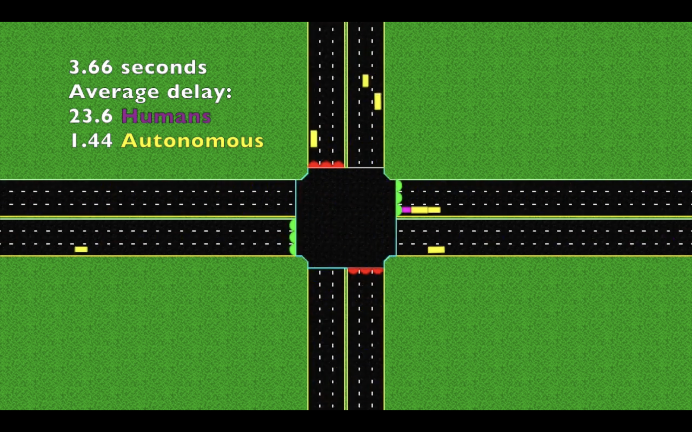
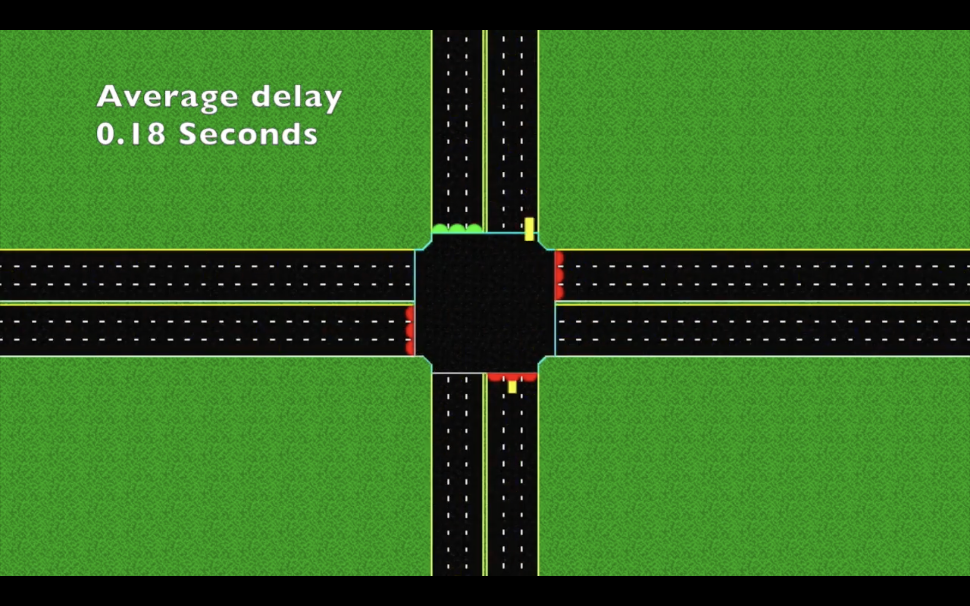
Motivation

Slide 4
Motivation
Time management
Efficiency (Crossing management)
Priority
Safety

Slide 5

Brainstorming

Slide 6
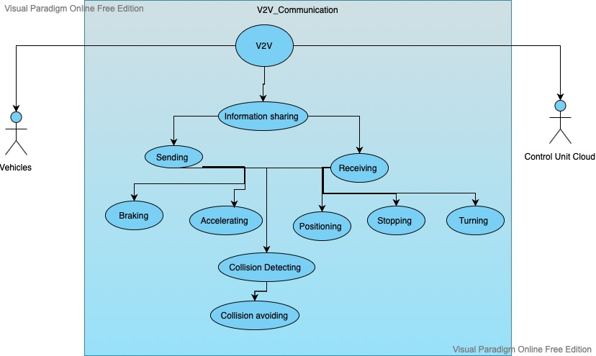
First approach for V2V
Use Case Diagram

Slide 7
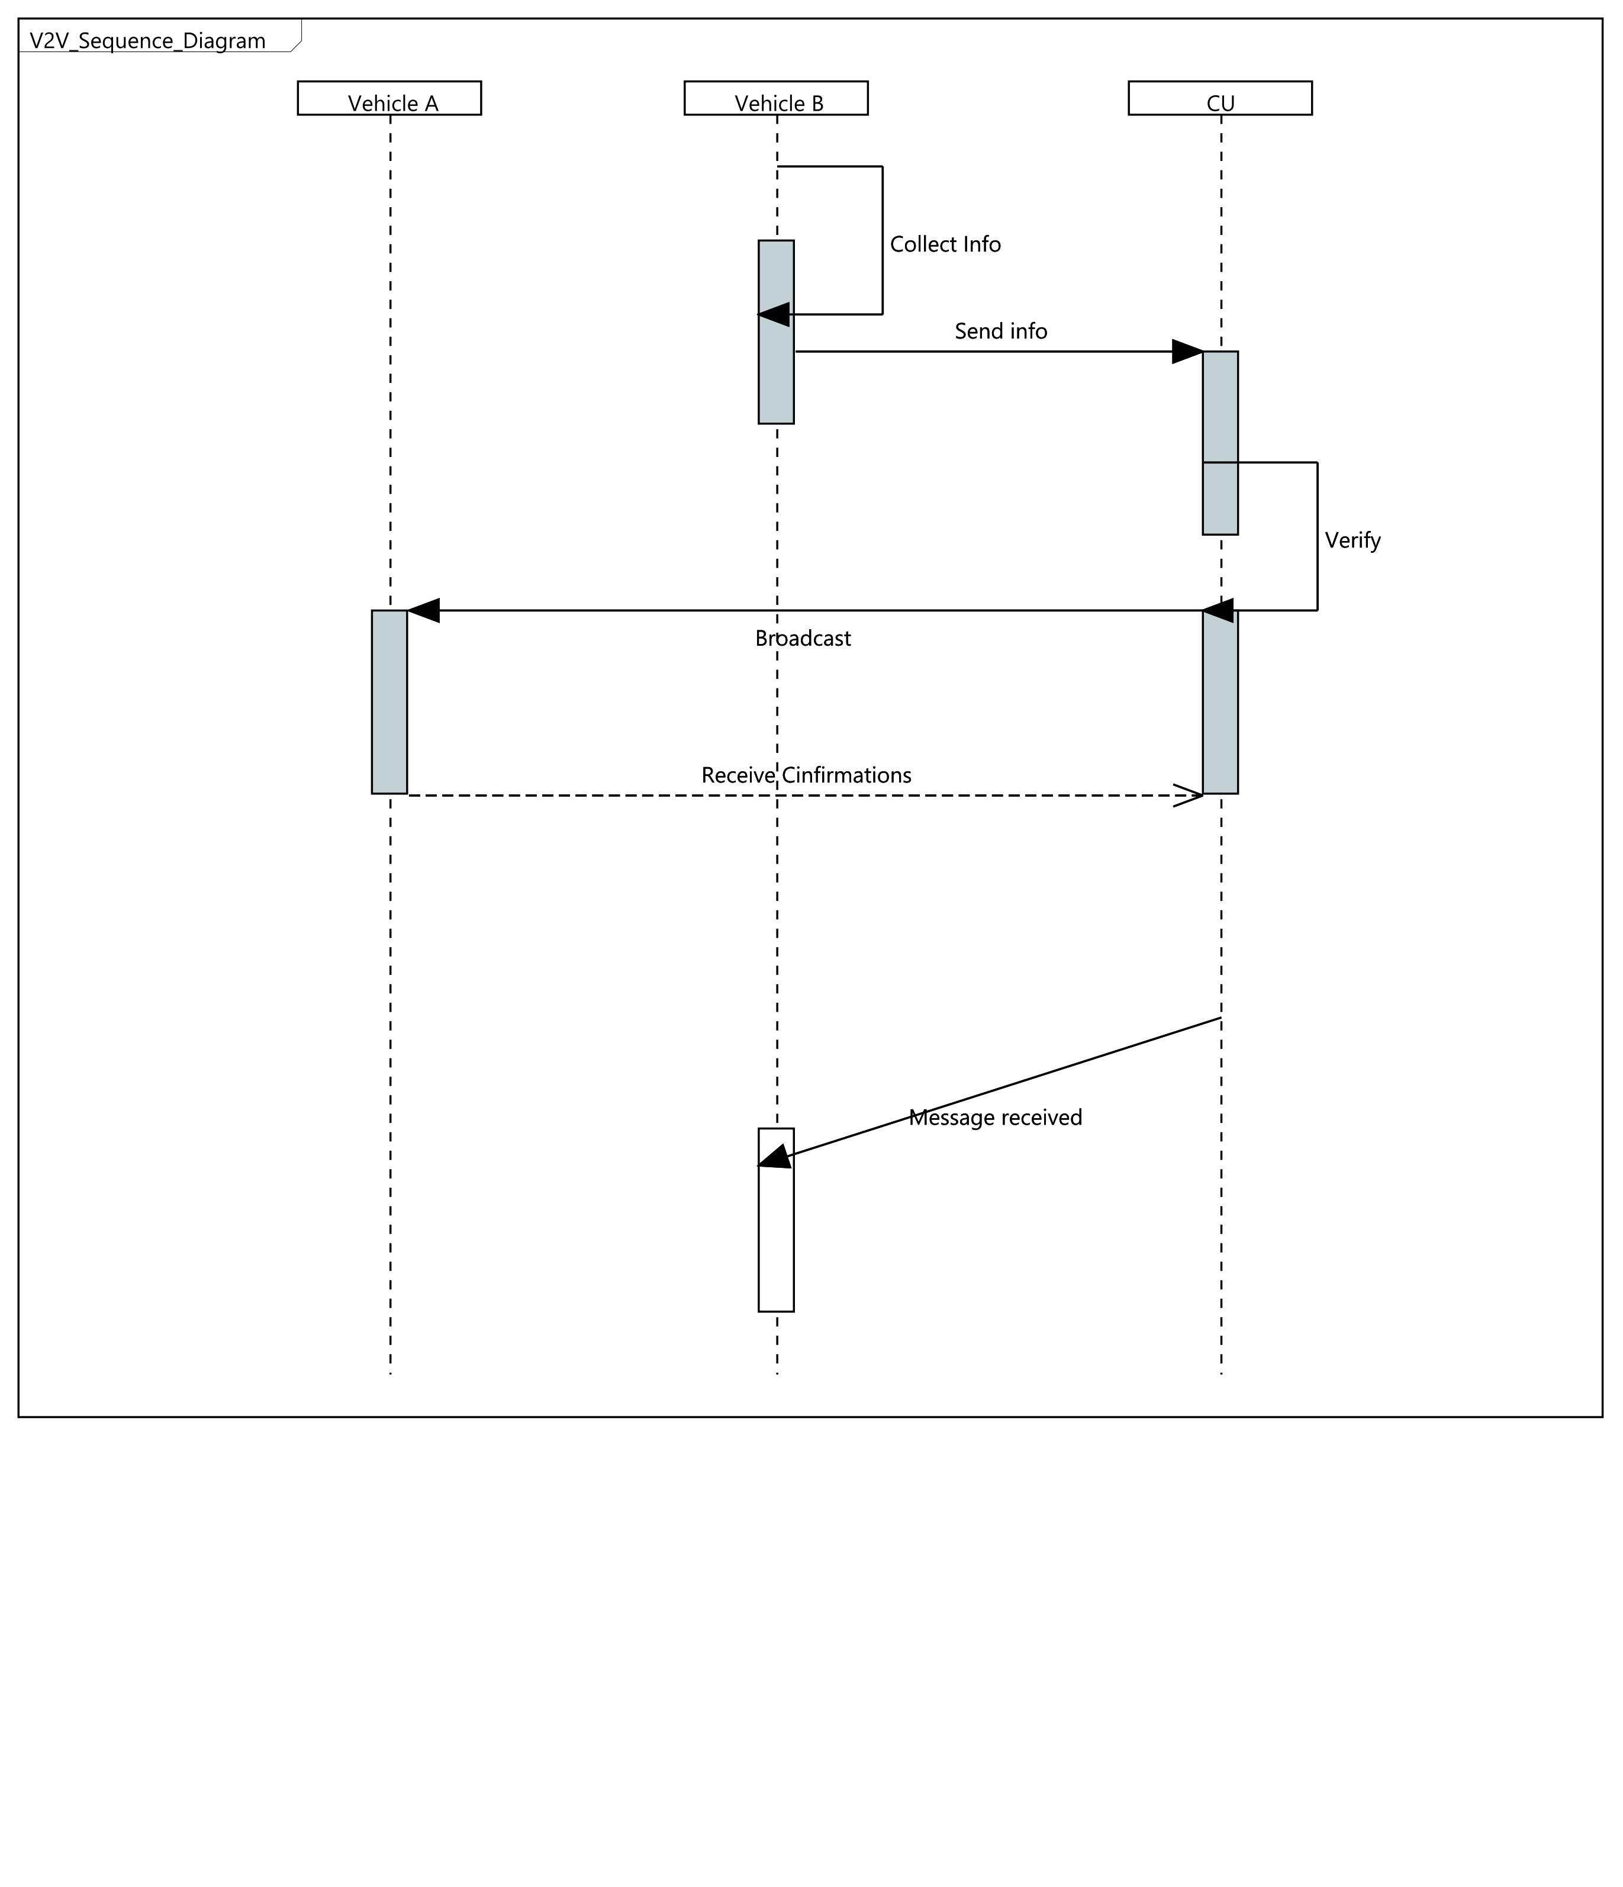
V2V Sequence Diagram

Slide 8
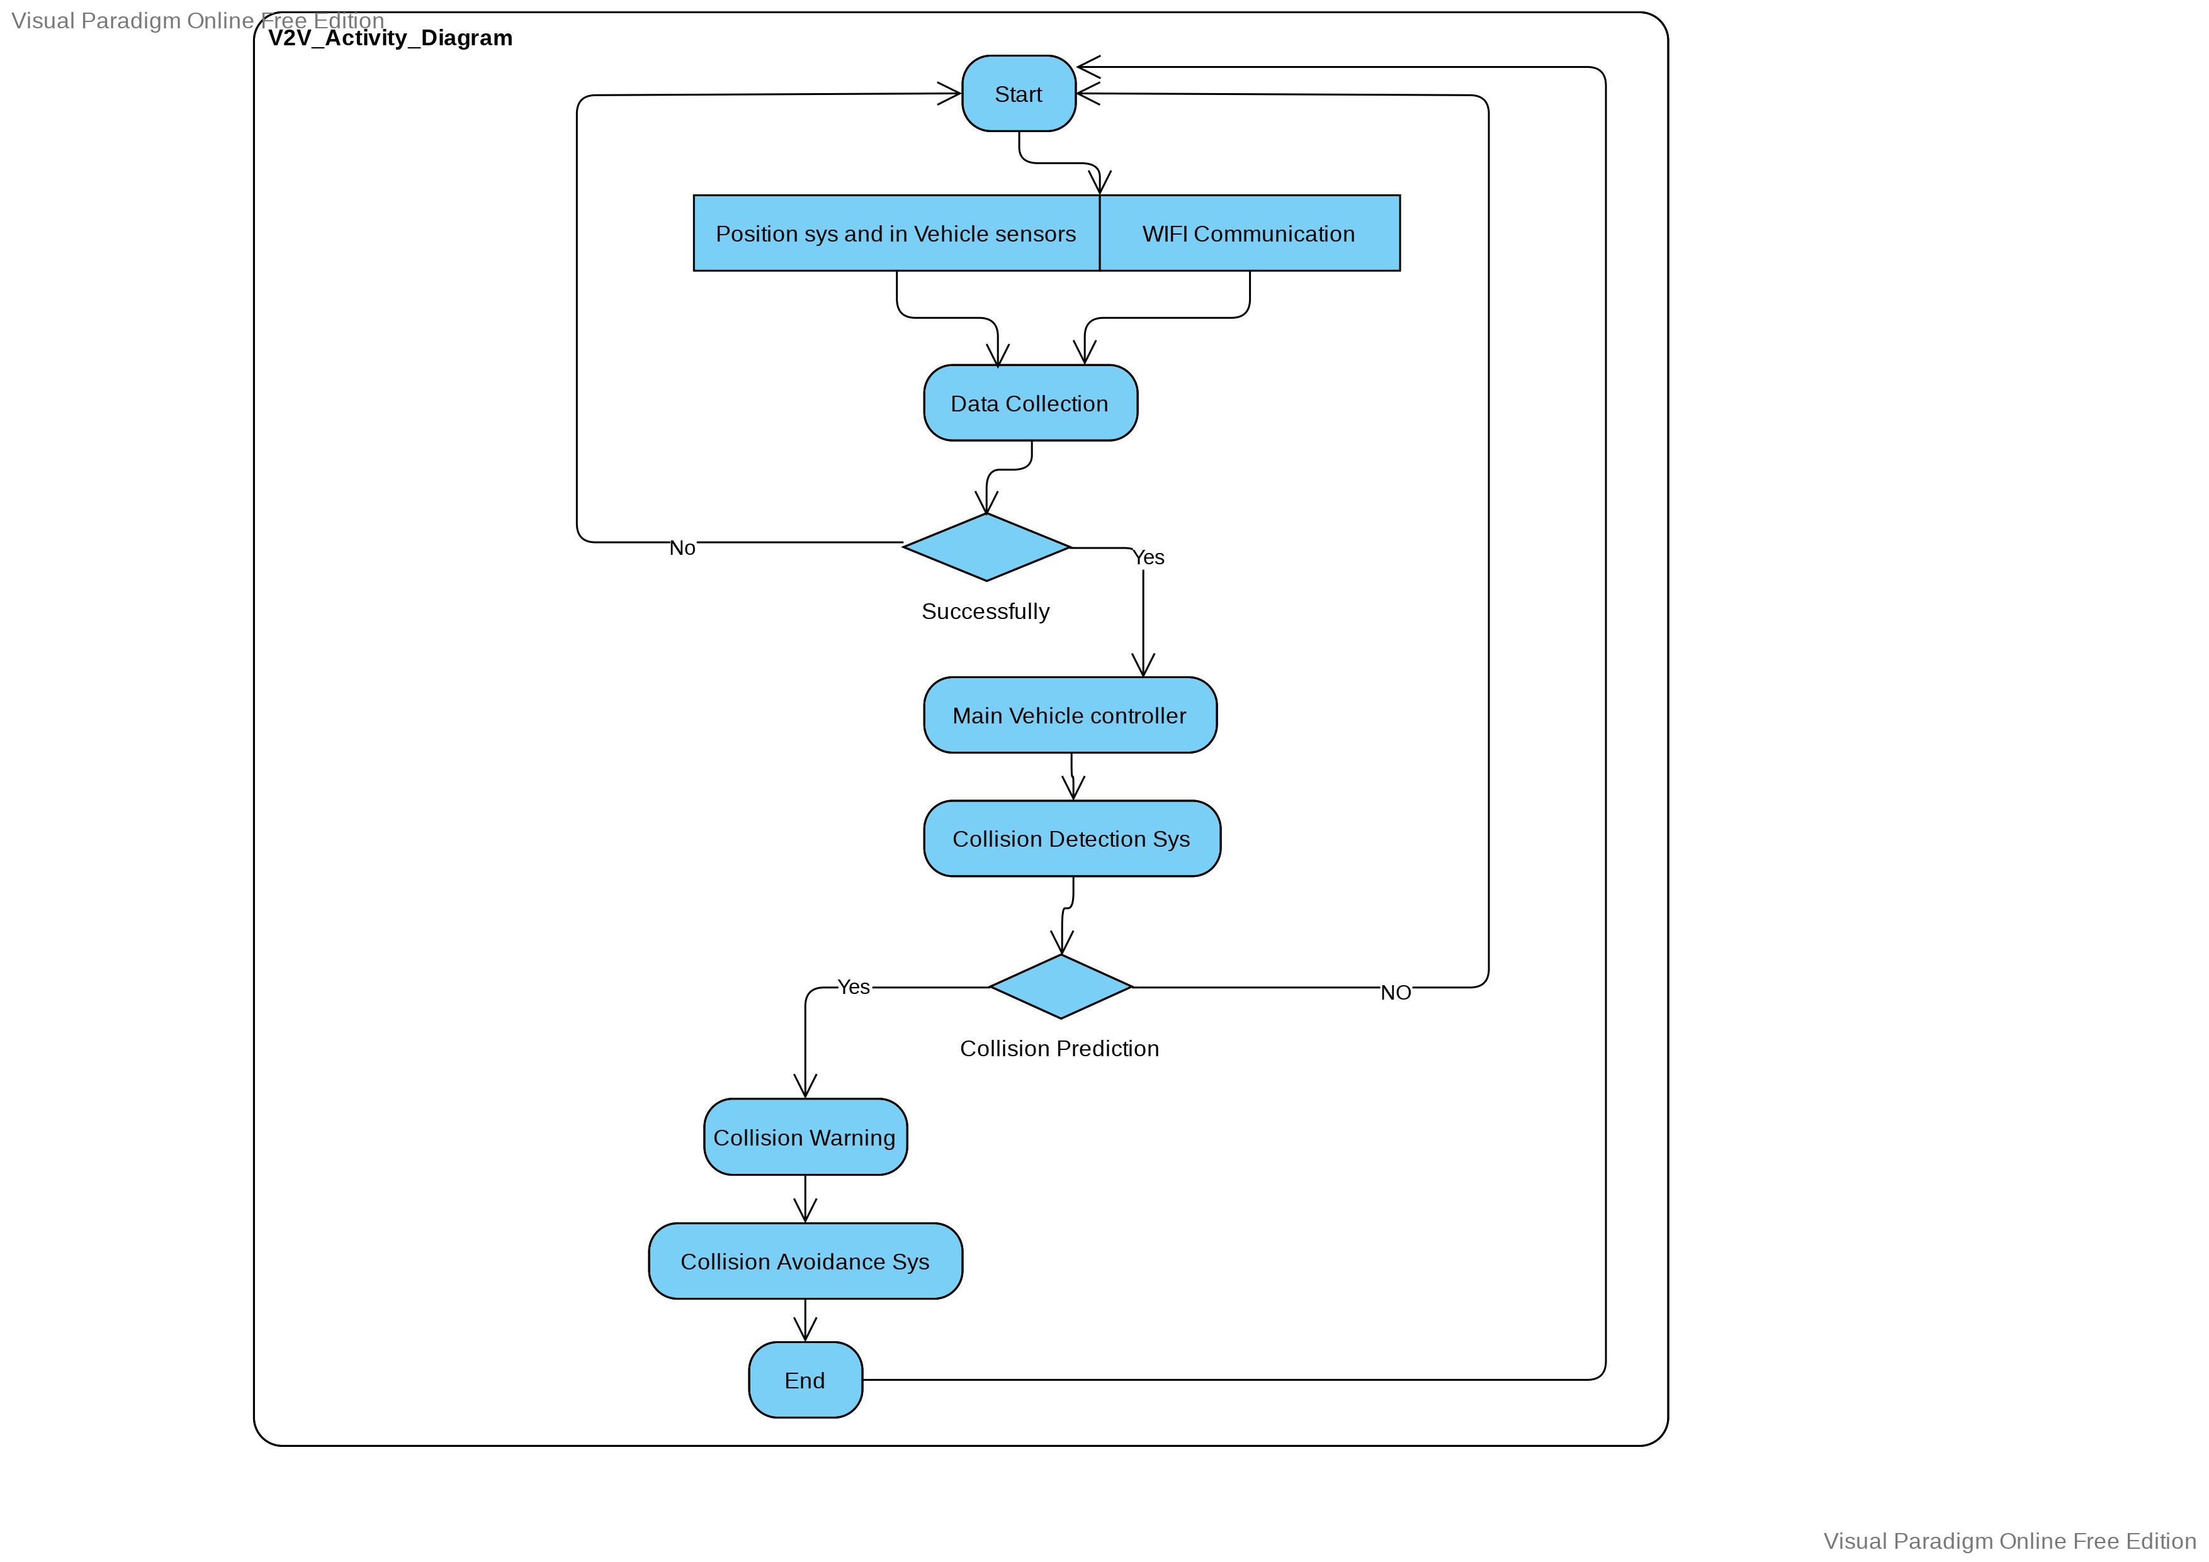
V2V Activity Diagram

Slide 9
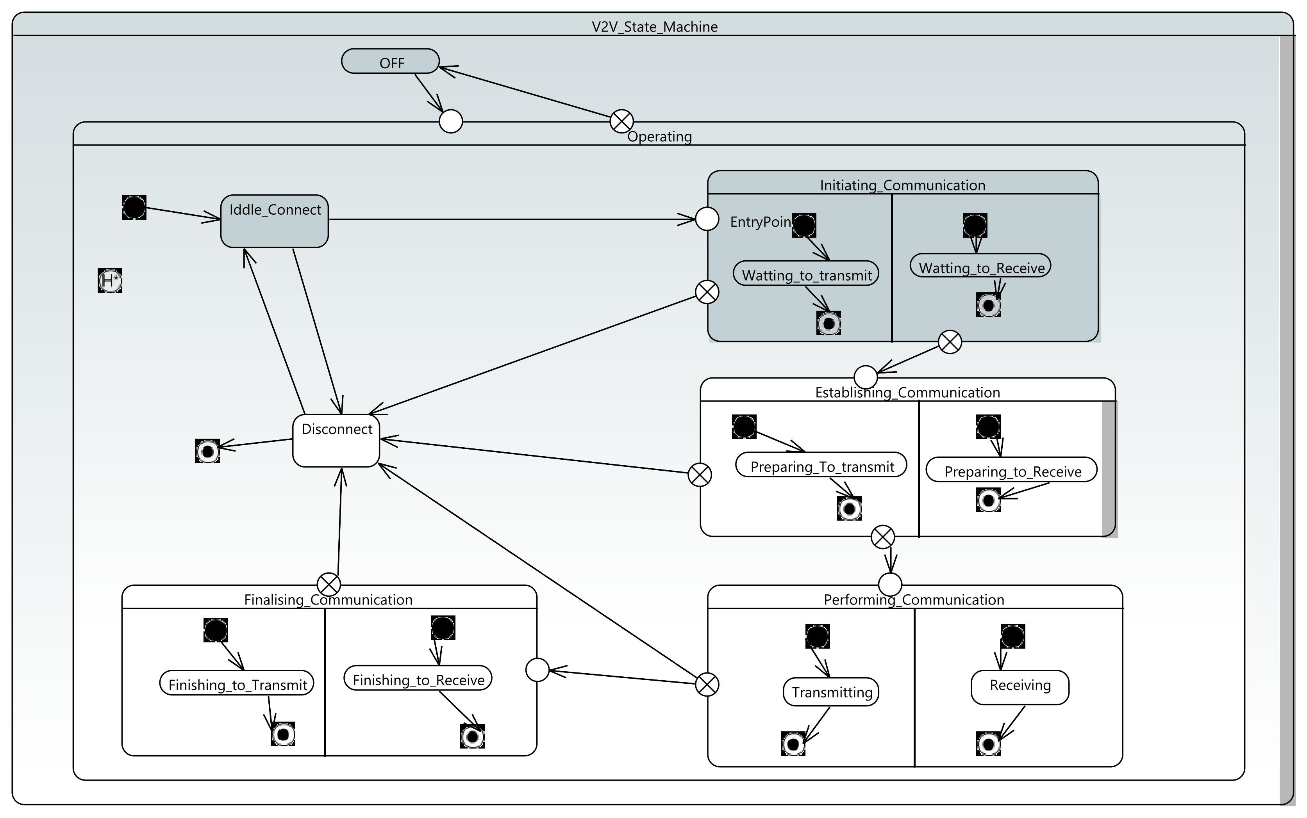
V2V State machine diagram
Concurrency behaviour

Slide 10
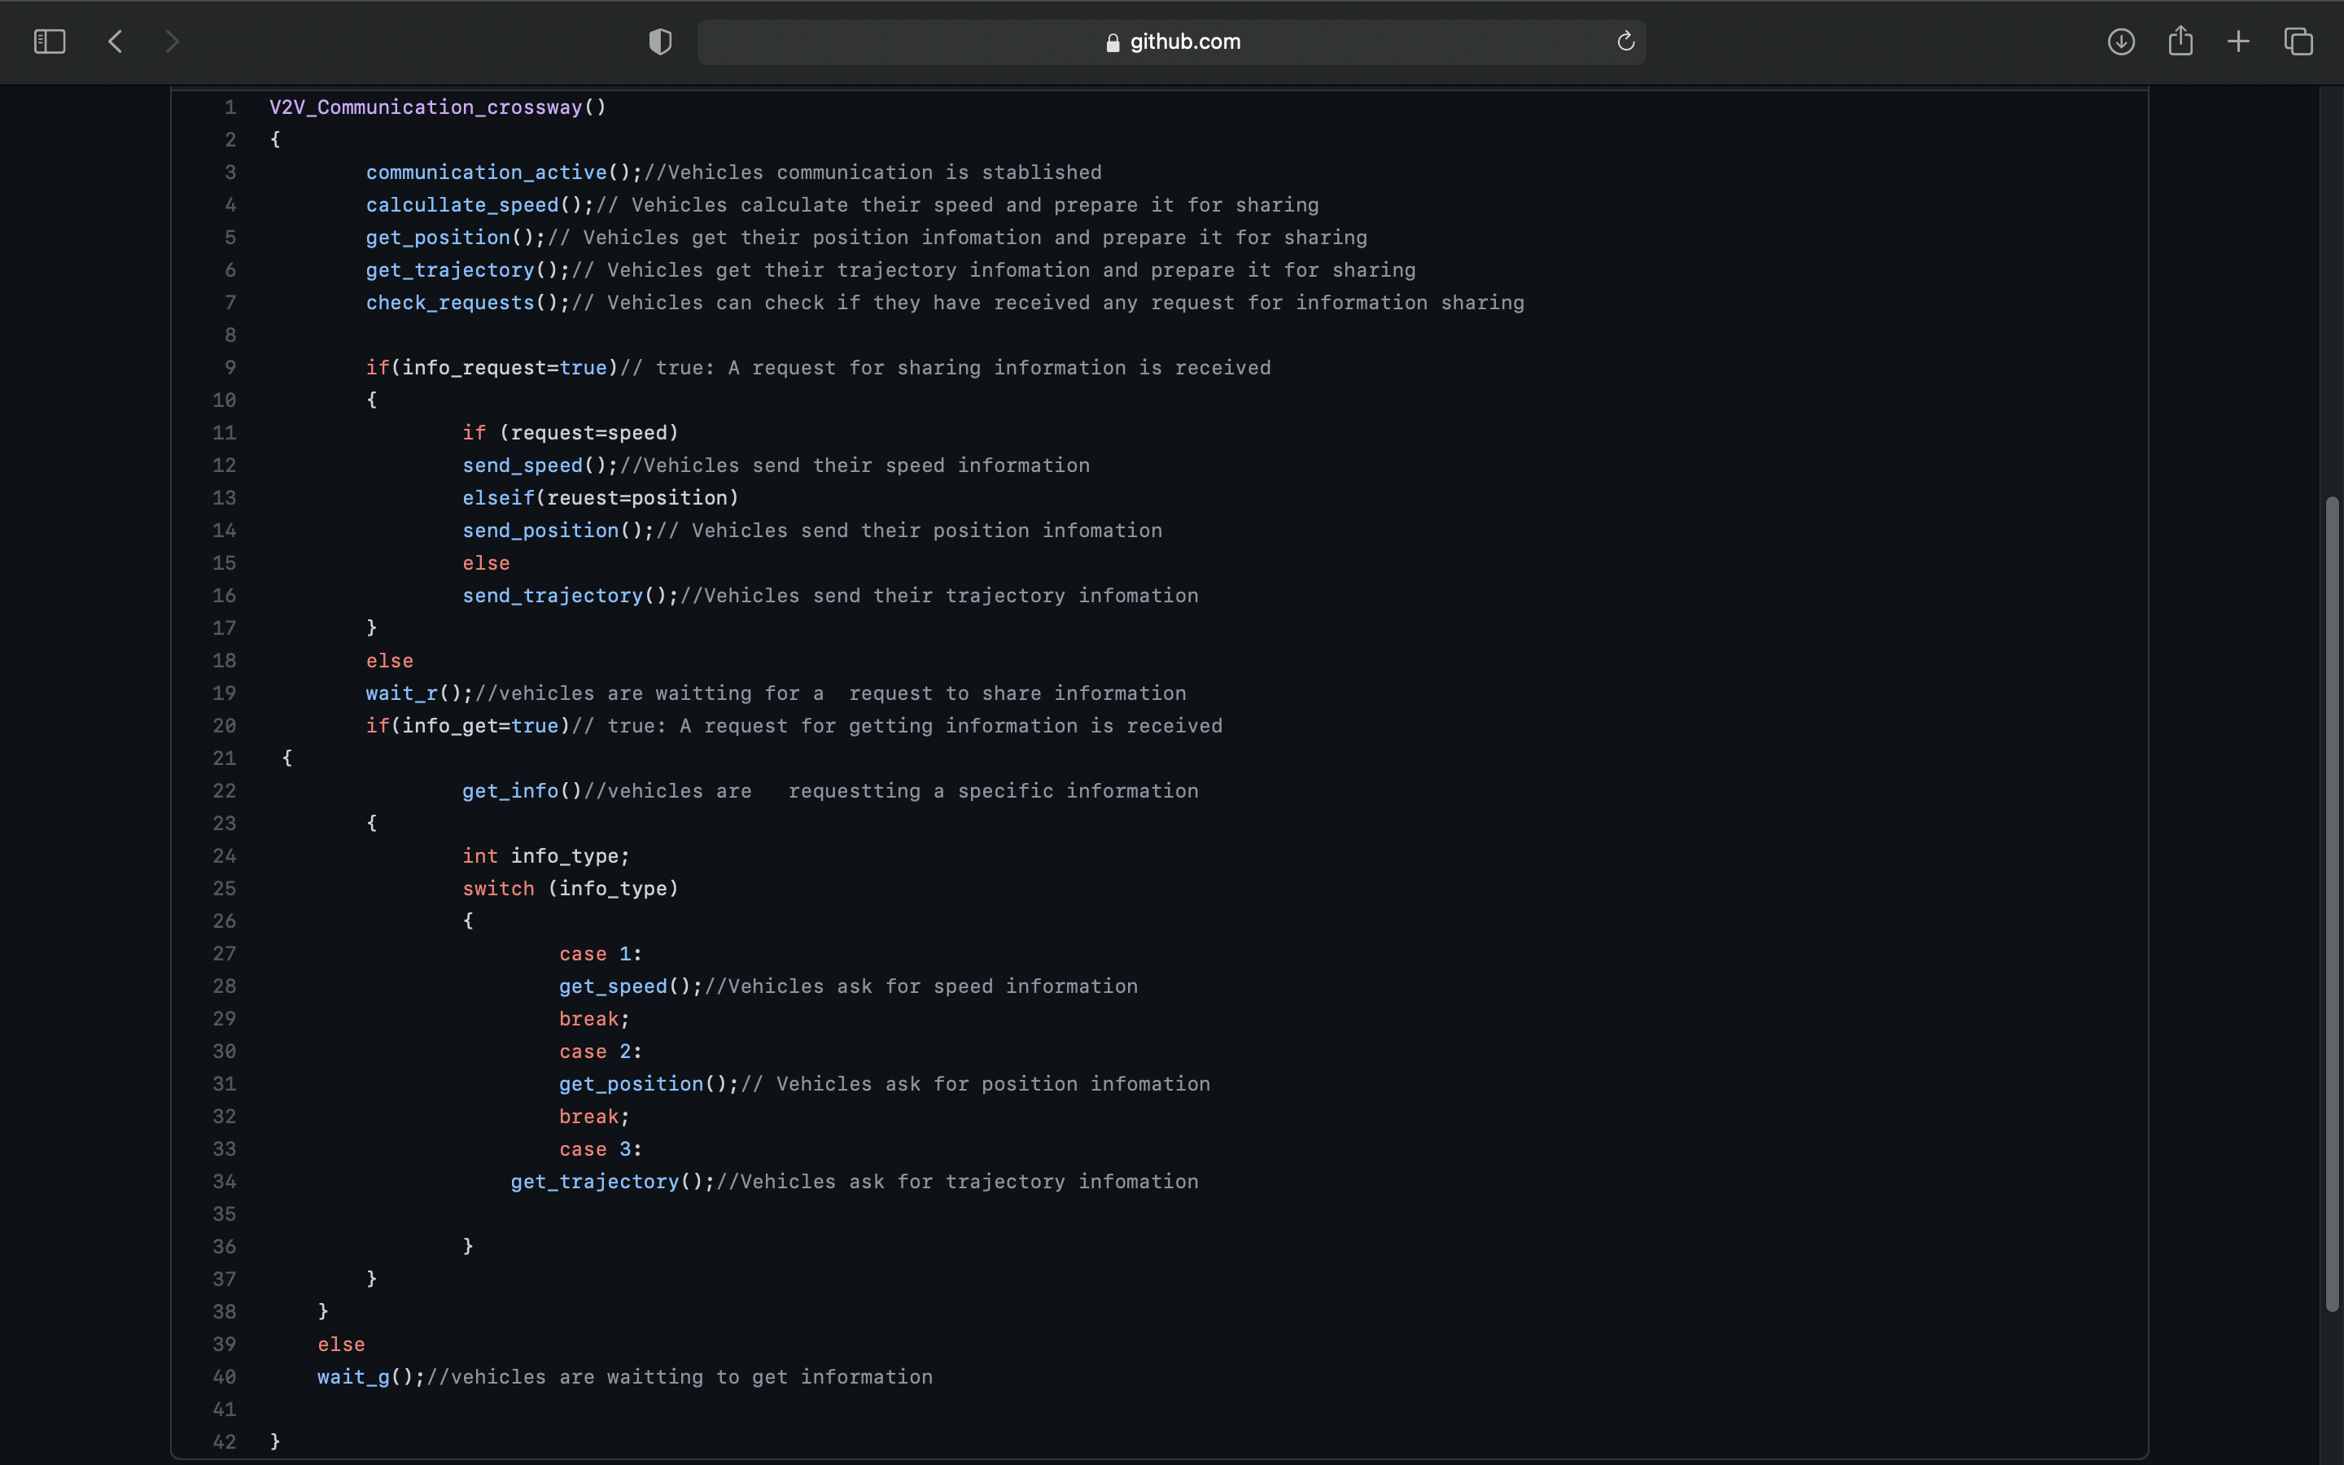
V2V Pseudocode
Communication in Cross-Section

Slide 11
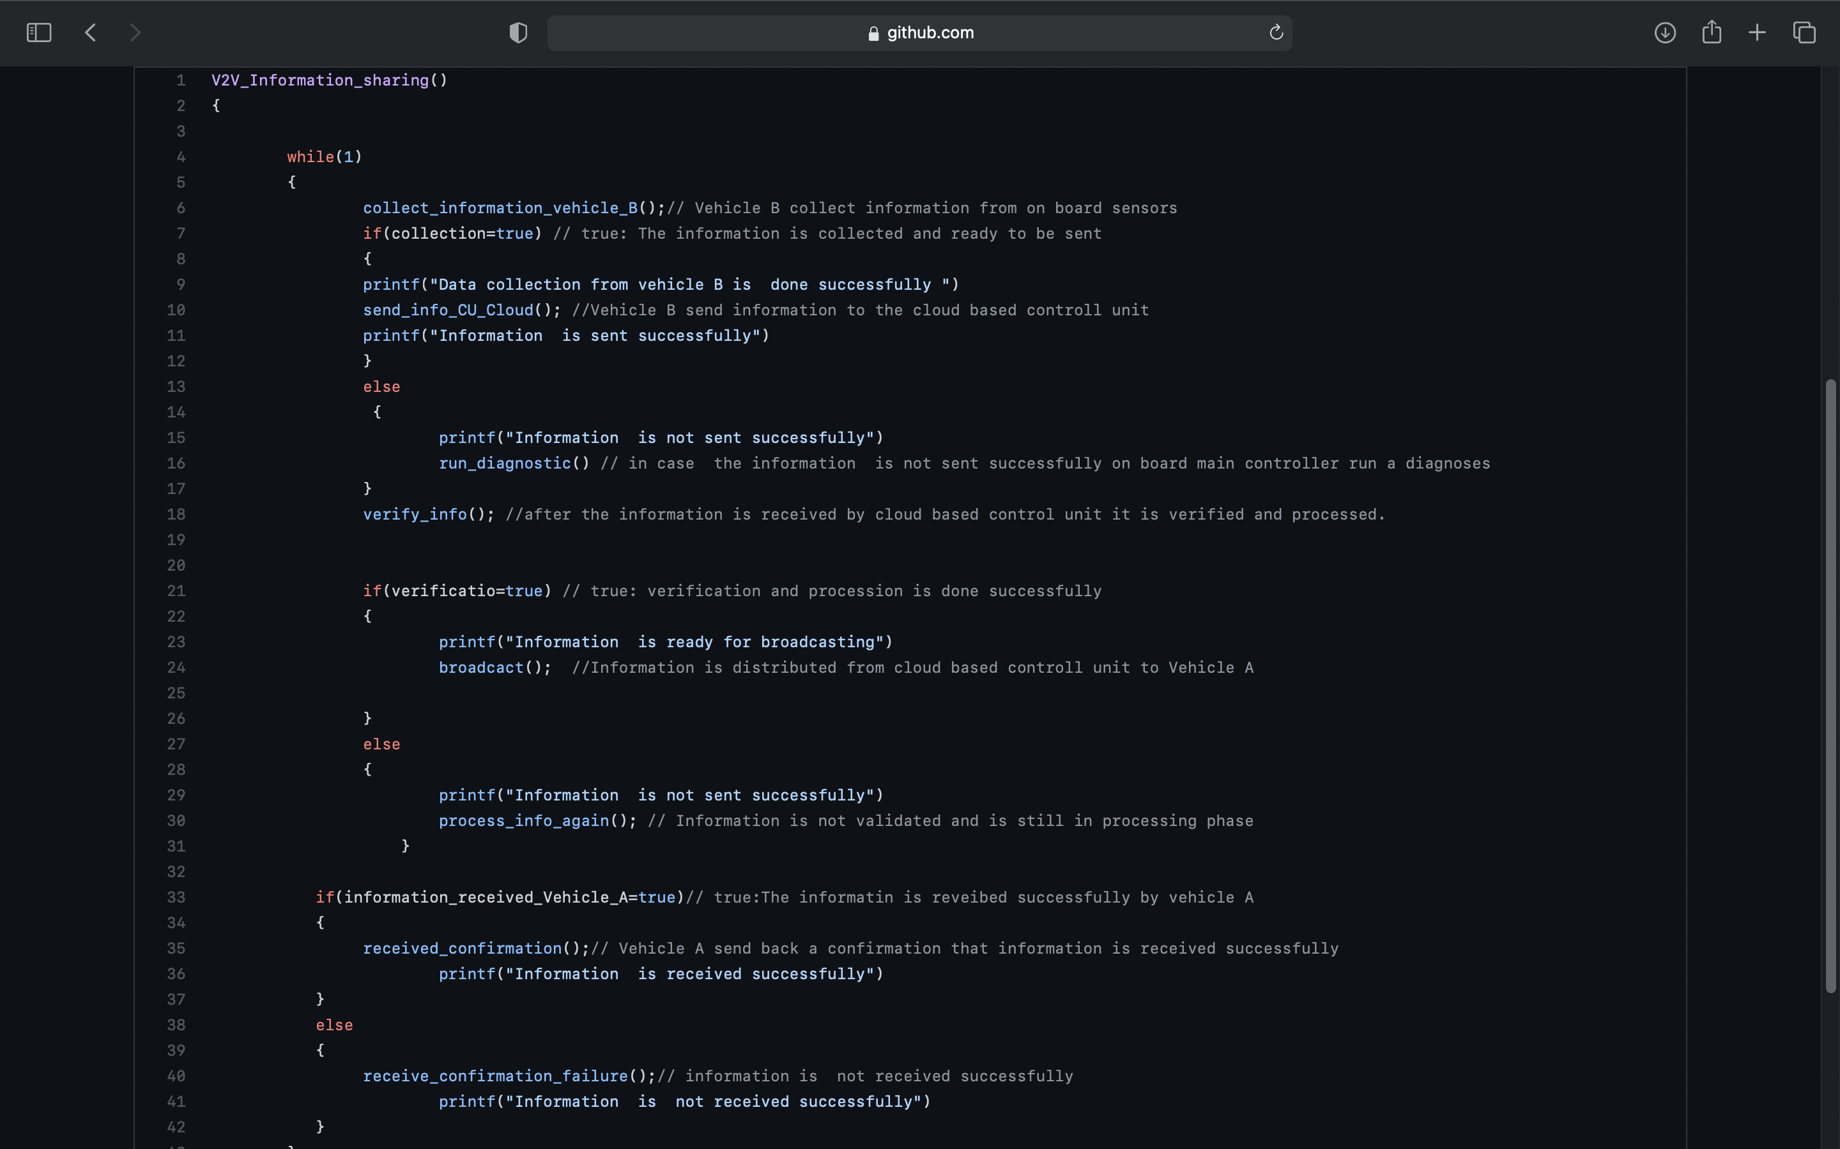
V2V Pseudocode
Sharing information through cloud based control unit.

Slide 12
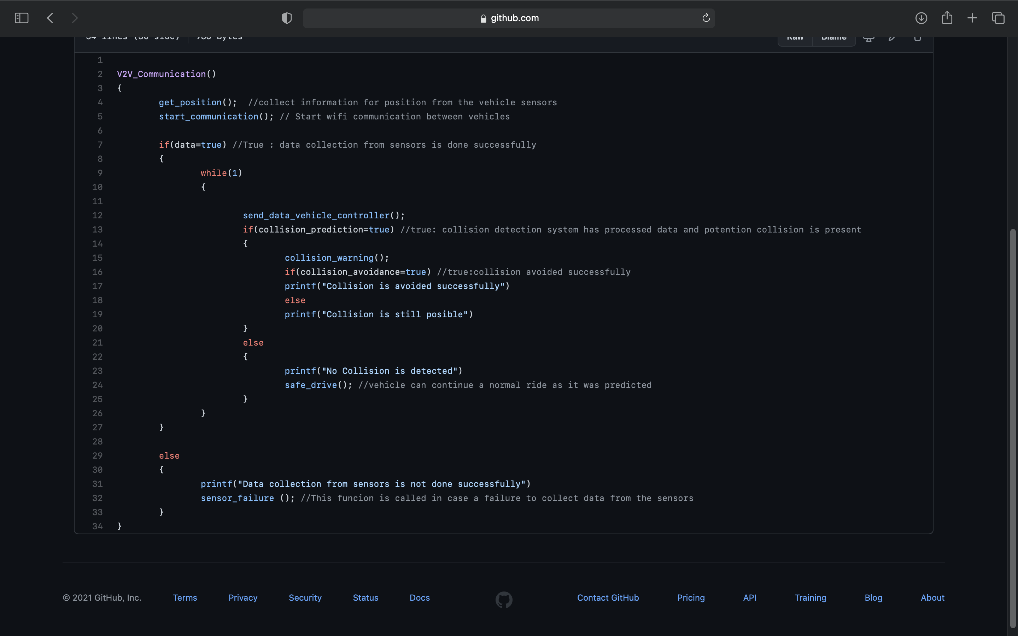
V2V Pseudocode
Pseudocode for Carla Simulator

Slide 13
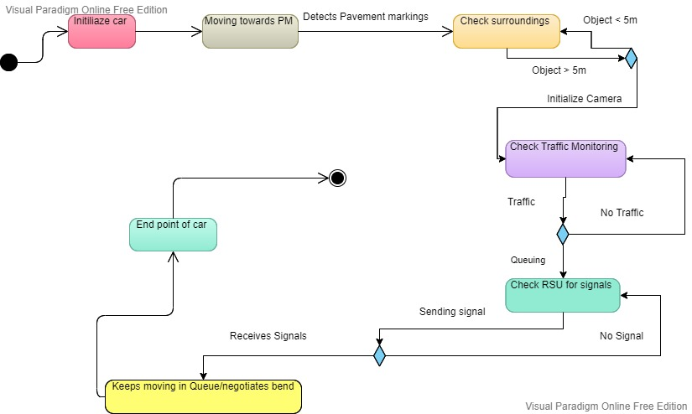
V2I State Activity Diagram

Slide 14
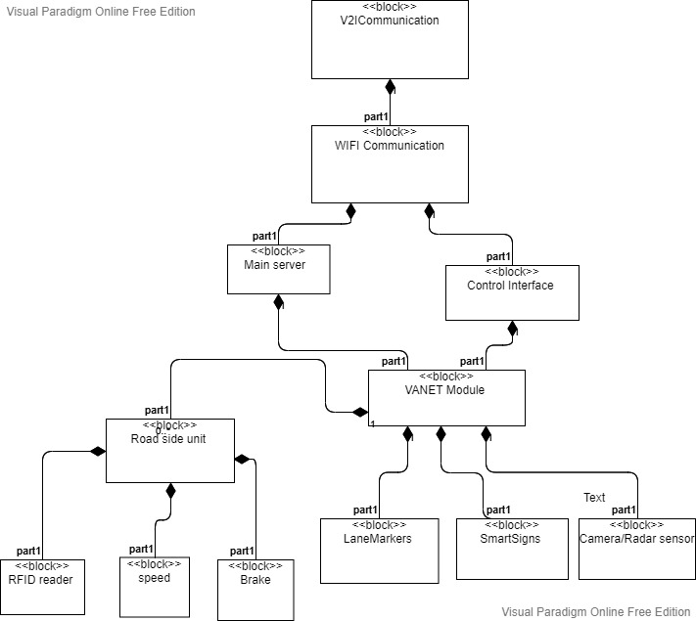
V2I BLOCK DIAGRAM

Slide 15
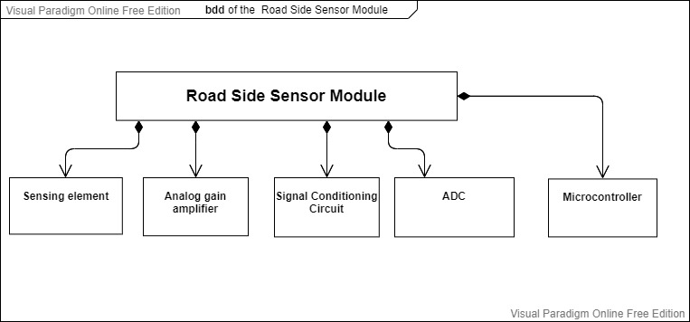
V2I (Control Side Unit)

Slide 16
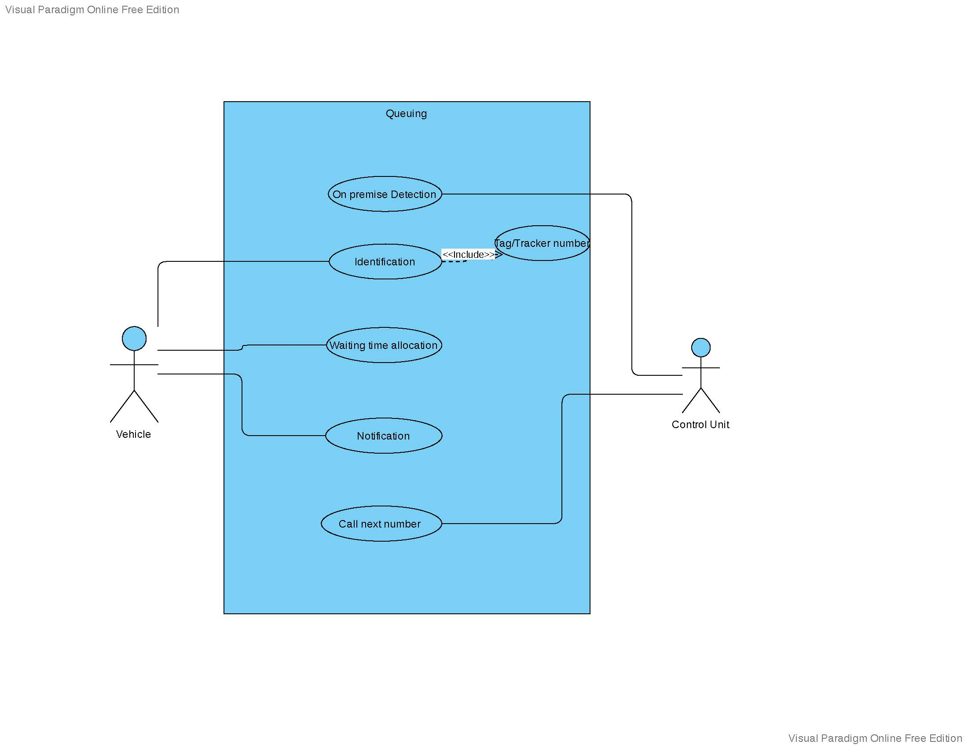
First approach for Queuing

Slide 17
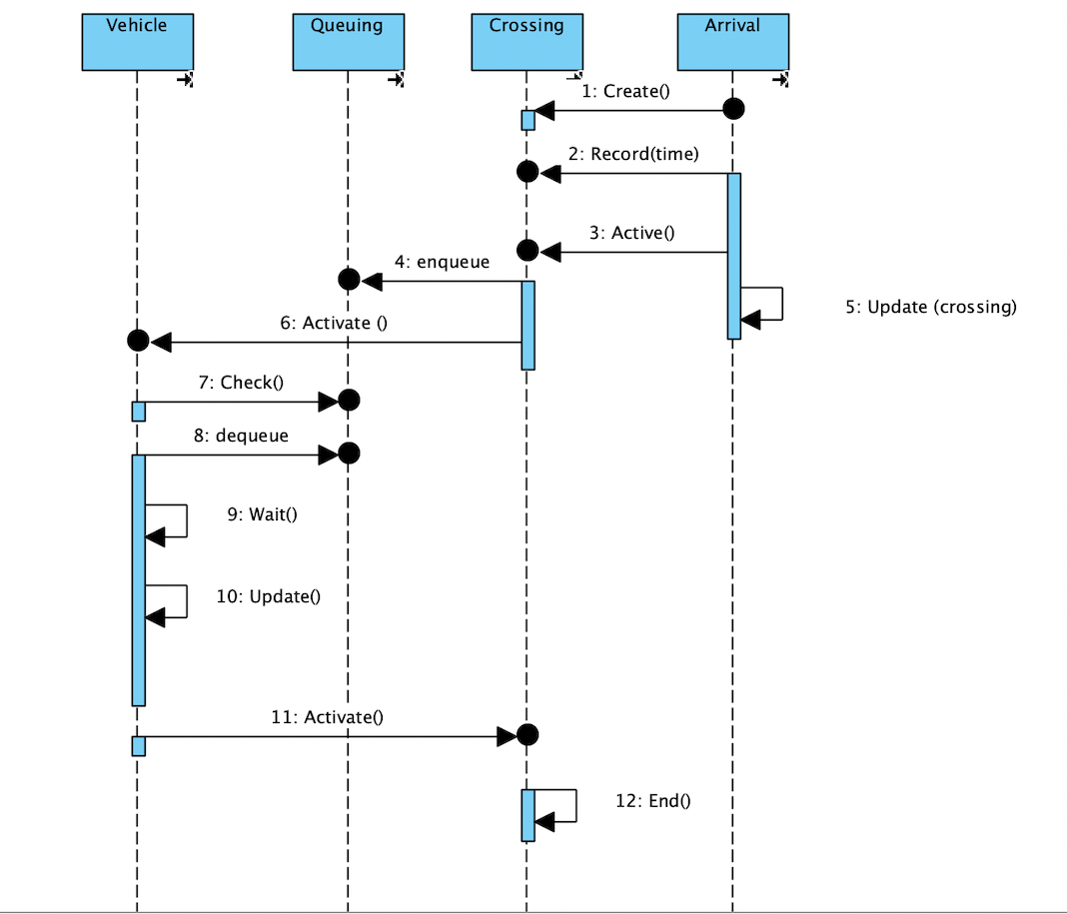
Sequence Diagram for Queuing

Slide 18
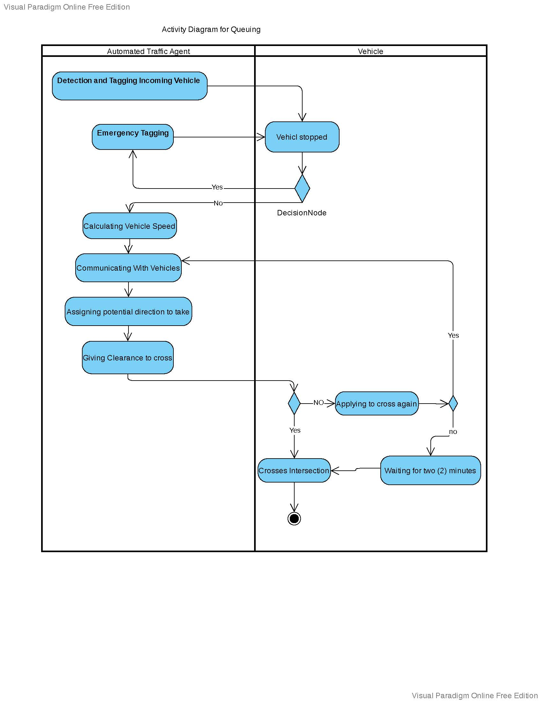
Activity Diagram for Queuing

Slide 19
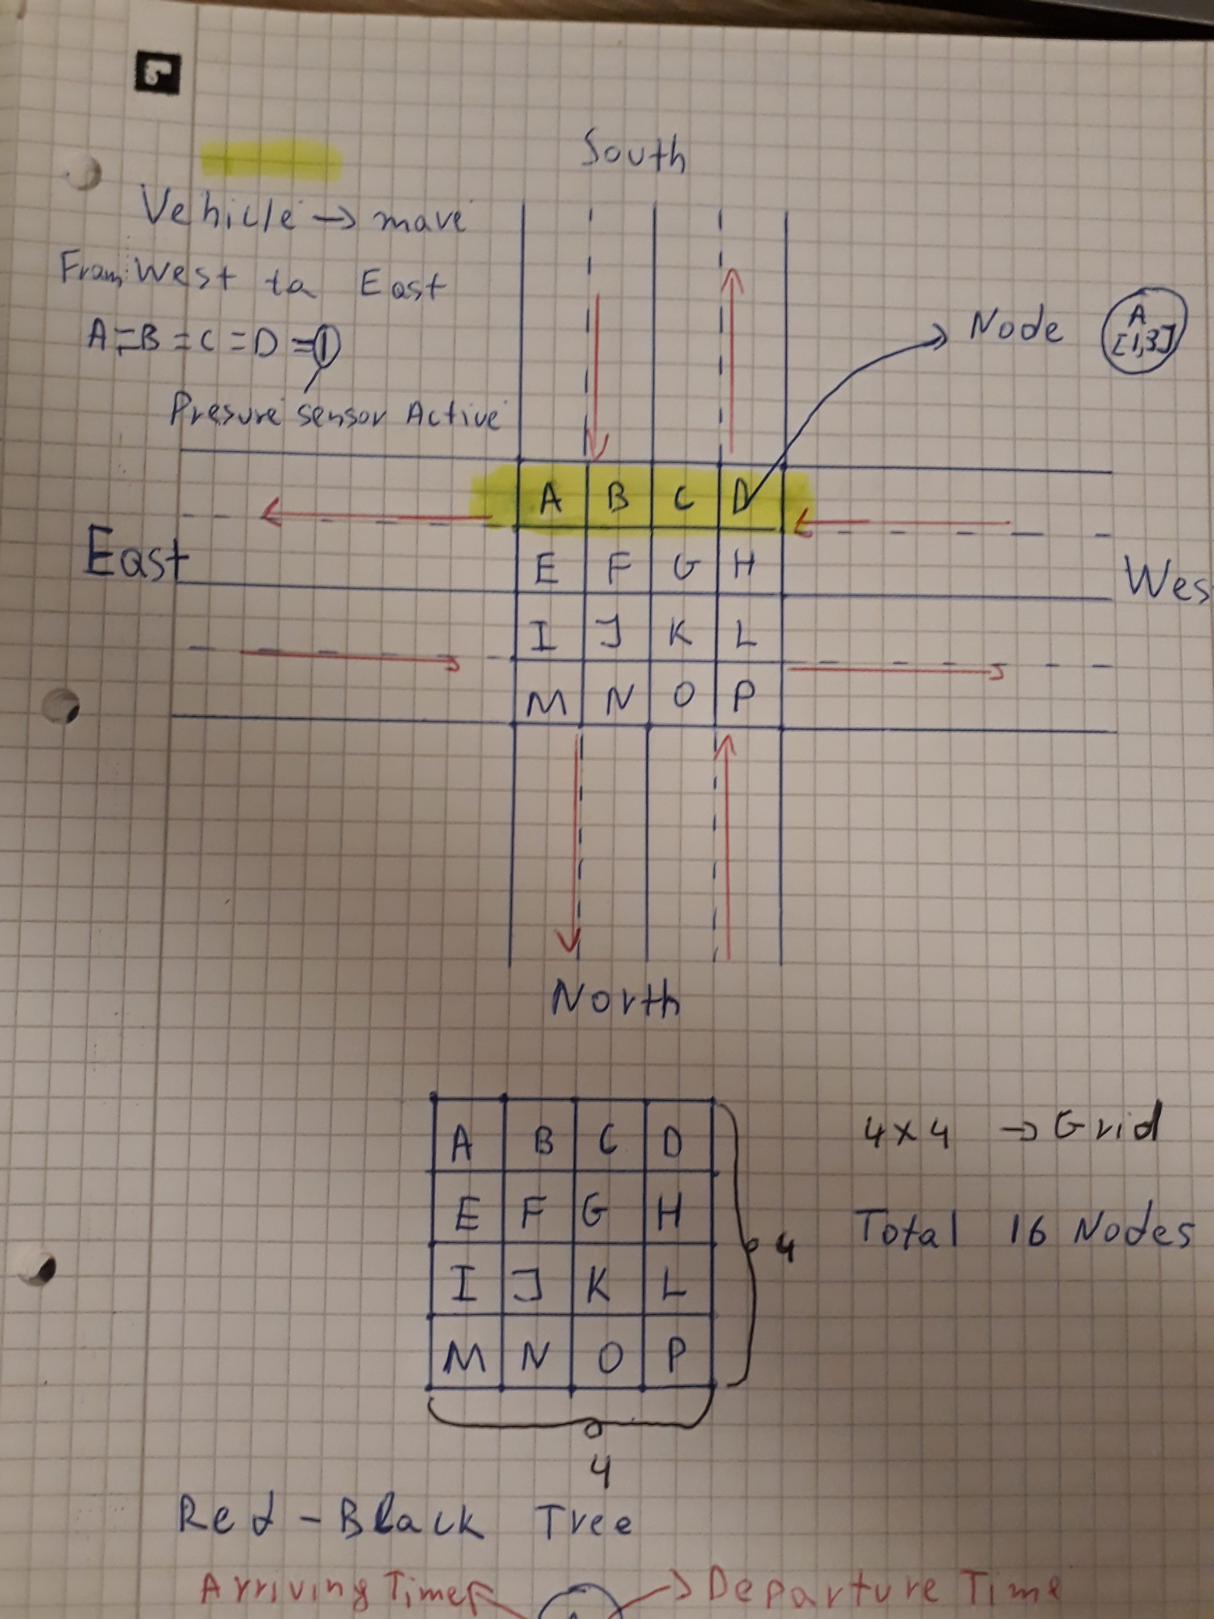
First Approach for Queuing
Elementary
Intermediate
Advanced

Slide 20
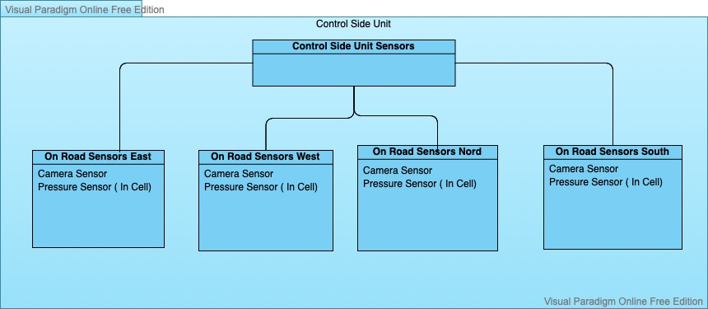
V2I Control Side Unit (Queuing)

Slide 21
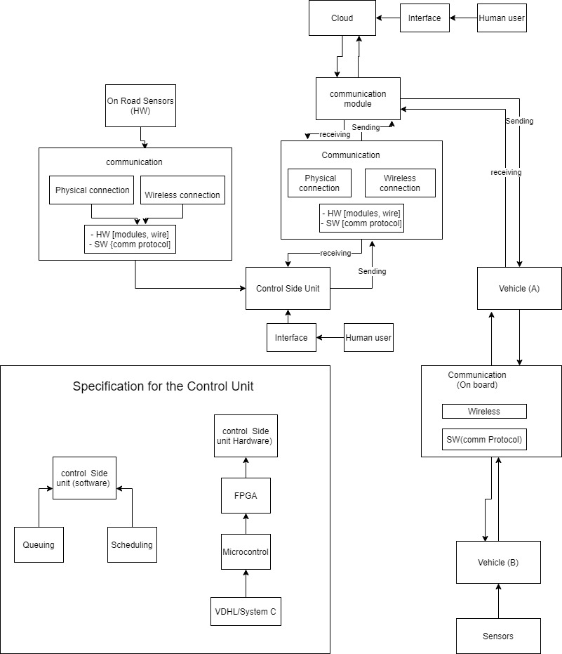
HW/SW In Cross Intersection

Slide 22
V2V implementation and simulation
Rtos implementation

Slide 23
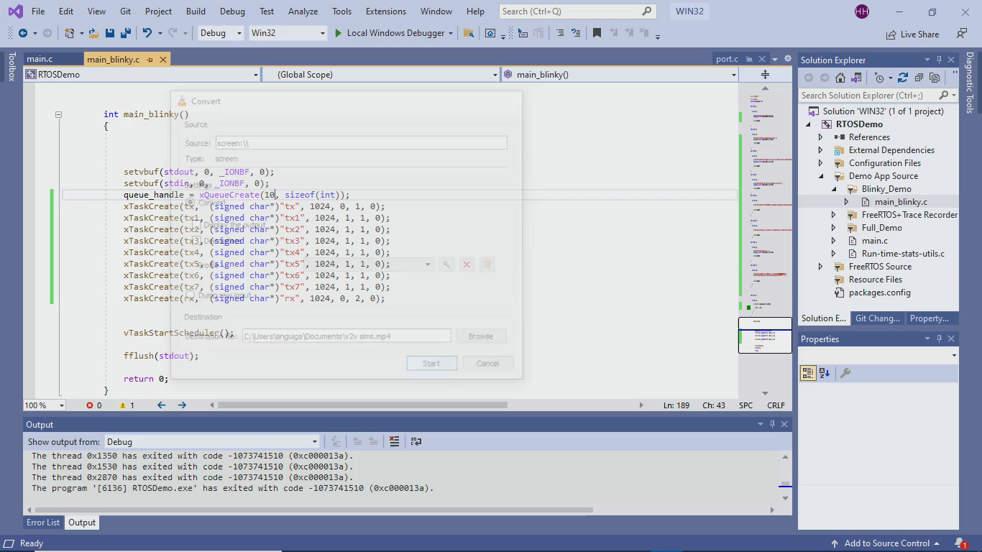
V2V implementation and simulation

Slide 24
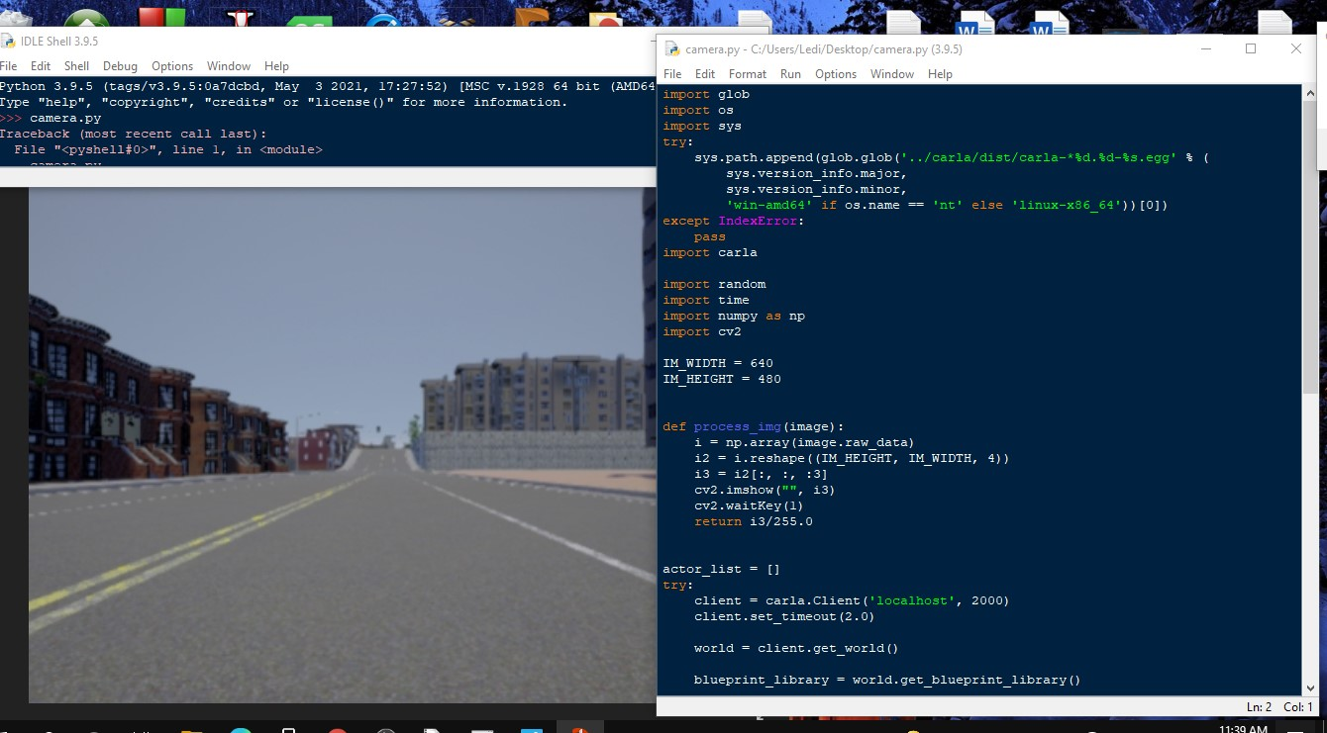
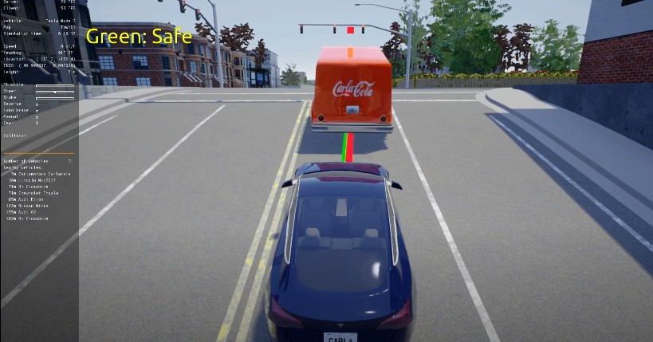
Carla Simulation

Slide 25
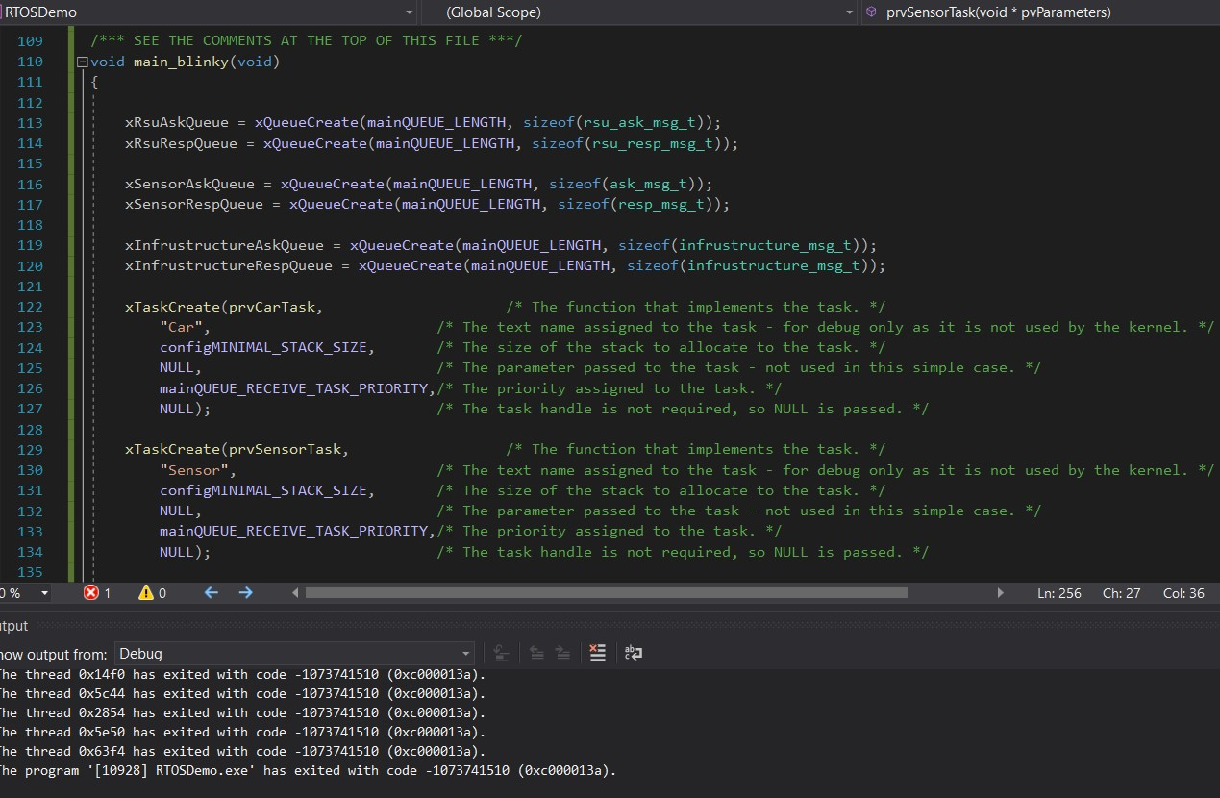
FreeRTOS TASK CREATION

Slide 26
V2I Implementation and Simulation

Slide 27
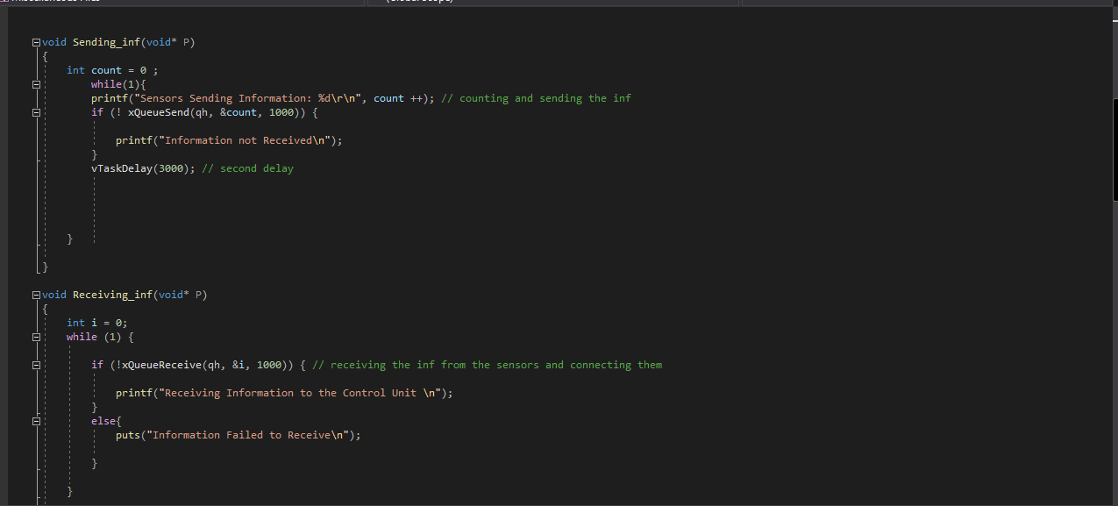
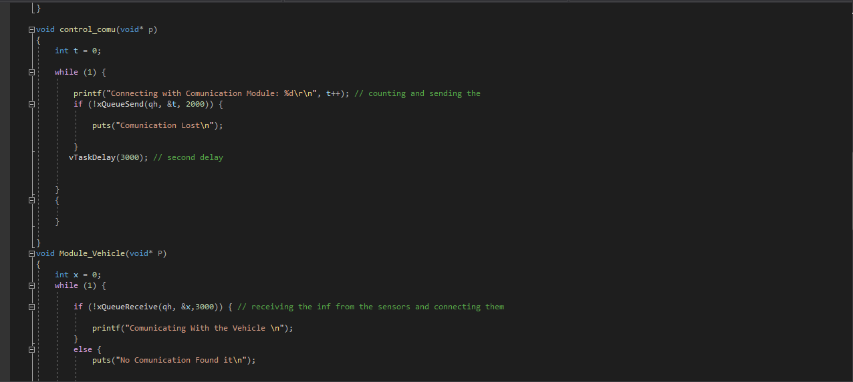
FreeRtos Sending and Receiving Information(INTERFACE)

Slide 28
V2I Implementation and Simulation
Communication and interface

Slide 29
Hardware simulation (Control Side Unit)

Slide 30
Conclusion
Future improvements
Carla Simulation
Grid Manipulation

Slide 31

Thank you for attention! Questions?

